Slide 1
Python Programming Part 1

Slide 2
Data Types
Integer <int>
Float <float>
String <str>
Boolean <bool>
For instance:
a = 5.0
b = 'Hola'
c = 5+6

Slide 3
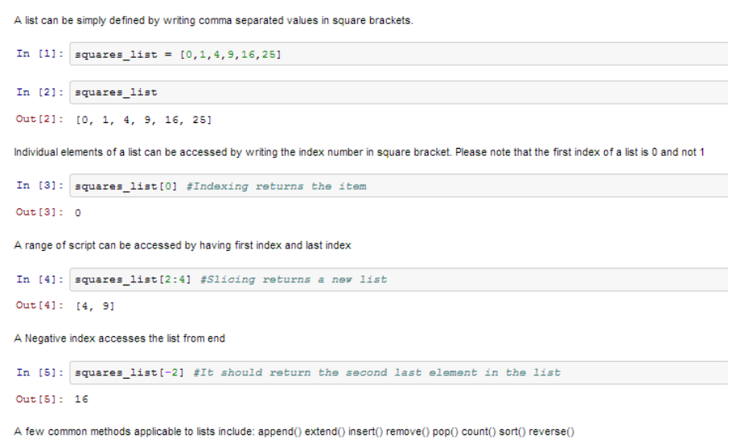
Lists
A list can simply be defined by writing a list of comma separated values in square brackets. Lists might contain items of different types, but usually the items all have the same type. Python lists are mutable and individual elements of a list can be changed.

Slide 4
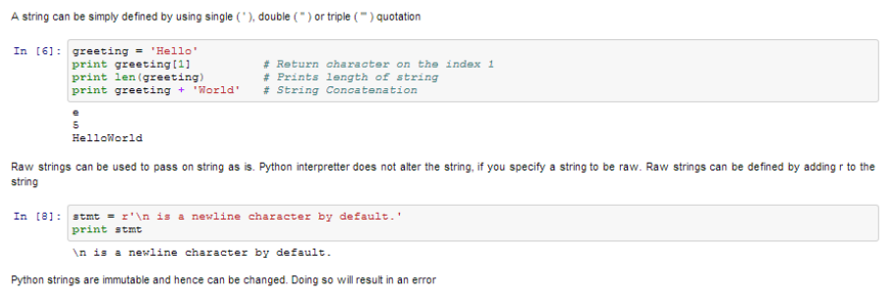
Strings
Strings can simply be defined by use of single ( ‘ ), double ( ” ) or triple ( ”’ ) inverted commas. Strings enclosed in tripe quotes ( ”’) can span over multiple lines. \ is used as an escape character.

Slide 5
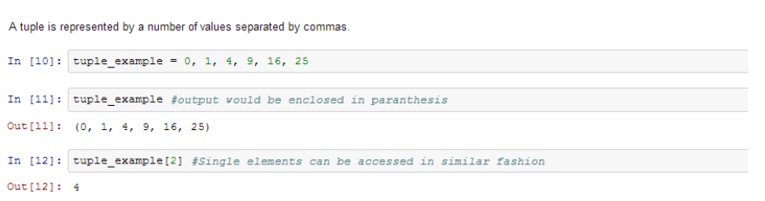
Tuples
A tuple is represented by a number of values separated by commas. Tuples are immutable and can not change, they are faster in processing as compared to lists. Hence, if your list is unlikely to change, you should use tuples, instead of lists.

Slide 6
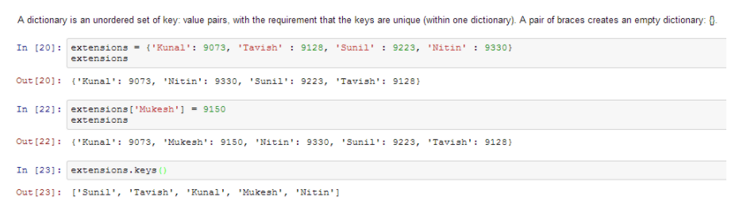
Dictionary
Dictionary is an unordered set of key: value pairs, with the requirement that the keys are unique (within one dictionary). A pair of braces creates an empty dictionary: {}.

Slide 7
Python iterations
Python also has a FOR-loop which is the most widely used method for iteration. It has a simple syntax:
for i in [Python Iterable]:
expression(i)
Here “Python Iterable” can be a list, tuple or other advanced data structures. Let’s take a look at a simple example.
for i in range(10):
print(i)

Slide 8
Conditional Statements
Conditional statements, these are used to execute code fragments based on a condition. The most commonly used construct is if-else, with following syntax:
if [condition]:
__execution if true__
else:
__execution if false__
For instance, if we want to print whether the number N is even or odd:
if N%2 == 0:
print ('Even')
else:
print ('Odd')

Slide 9
Defining a function
In Python a function is defined using the def keyword:
def my_function():
print("Hello from a function")
Calling a function
def my_function():
print("Hello from a function")
my_function()

Slide 10
Defining a function Cond.
Arguments
Arguments are specified after the function name, inside the parentheses. You can add as many arguments as you want, just separate them with a comma.
def my_function(fname, lname):
print(fname + " " + lname)
my_function("Kazi", "Zainab")

Slide 11
Defining a function Cond.
Passing a List as an Argument
You can send any data types of argument to a function (string, number, list, dictionary etc.), and it will be treated as the same data type inside the function.
def my_function(food):
for x in food:
print(x)
fruits = ["apple", "banana", "cherry"]
my_function(fruits)

